Slide 1


CS-446: Information Systems Security
Chapter # 12: HTTPS: Goals and Pitfalls
Prof. Dr. Sufian Hameed
Department of Computer Science
FAST-NUCES

Slide 2
Overview
HTTPS
SSL/TLS Overview
HTTPS in the Browser
Problems with HTTPS and the Lock Icon

Slide 3
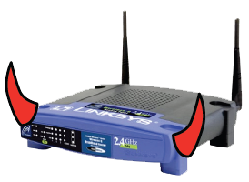
Threat Model: Network Attacker
Network Attacker:
Controls network infrastructure: Routers, DNS
Passive attacker: only eavesdrops on net traffic
Active attacker: eavesdrops, injects, blocks, and modifies packets
Examples:
Wireless network at Internet Café
Internet access at hotels (untrusted ISP)

Slide 4

Certificates
How does Alice (browser) obtain PK_{Bob} ?
Browser Alice
Server Bob
CA
choose
(SK,PK)
PK and
proof “I am Bob”
check
proof
PK_{CA}
PK_{CA}
SK_{CA}
issue Cert with SK_{CA} :
verify
Cert
Bob’s key is PK
Bob’s key is PK
Bob uses Cert for an extended period (e.g. one year)

Slide 5
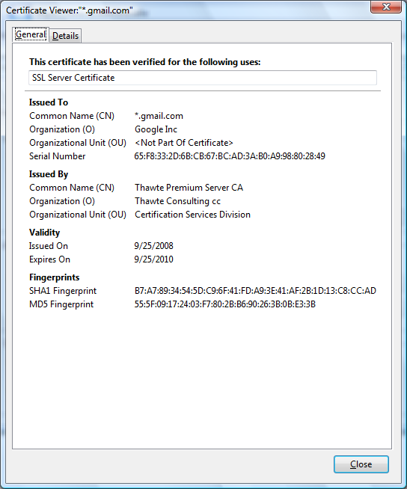
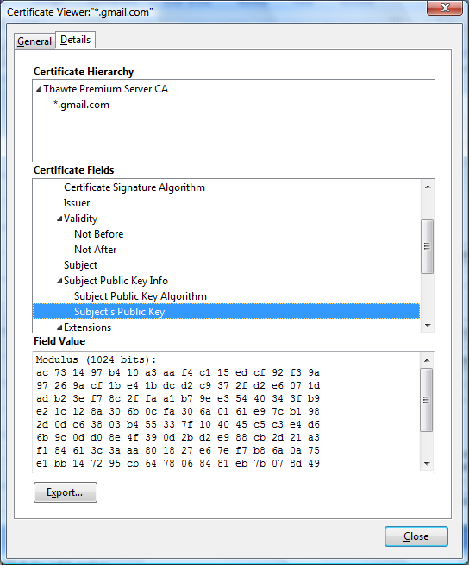
Certificates: example
Important fields:

Slide 6
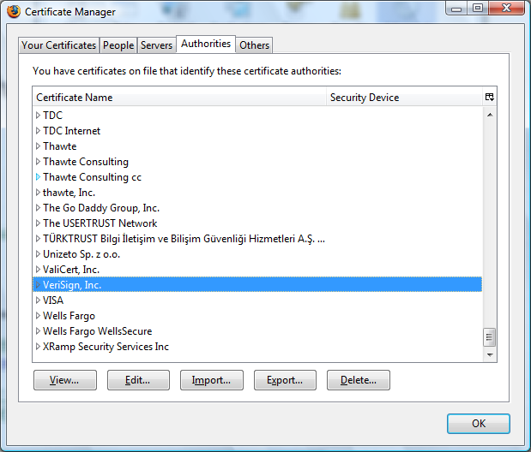
Certificate Authorities
Browsers accept certificates from a large number of CAs
top level CAs ≈ 600
Intermediate CAs ≈ 1200

Slide 7
SSL/TLS overview
Both protocol basic working is same
Below slides are taken from chapter 17 of Cryptography and Network Security, 3e (SIE), 3/e, so please don’t confuse with chapter number.

Slide 8
Chapter 17
Objectives
❏ To discuss the need for security services at the transport layer of the Internet model
❏ To discuss the general architecture of SSL
❏ To discuss the general architecture of TLS
❏ To compare and contrast SSL and TLS

Slide 9
Secure Sockets Layer (SSL) and Transport Layer Security (TLS) are cryptographic security protocols.
They are used to make sure that network communication is secure.
Their main goals are to provide data integrity and communication privacy (confidentiality).
The SSL protocol was the first protocol designed for this purpose and TLS is its successor.
SSL is now considered obsolete and insecure (even its latest version), so modern browsers such as Chrome or Firefox use TLS instead.
SSL and TLS are commonly used by web browsers to protect connections between web applications and web servers. Many other TCP-based protocols use TLS/SSL as well, including email (SMTP/POP3), instant messaging (XMPP), FTP, VoIP, VPN, and others.

Slide 10
Typically, when a service uses a secure connection the letter S is appended to the protocol name, for example, HTTPS, SMTPS, FTPS, SIPS. In most cases, SSL/TLS implementations are based on the OpenSSL library.
SSL and TLS are frameworks that use a lot of different cryptographic algorithms, for example, RSA and various Diffie–Hellman algorithms.
The parties agree on which algorithm to use during initial communication. The latest TLS version (TLS 1.3) is specified in the IETF (Internet Engineering Task Force) document RFC 8446 and the latest SSL version (SSL 3.0) is specified in the IETF document RFC 6101.

Slide 11
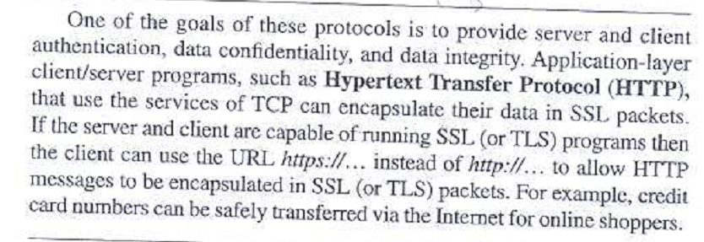
SSL and TLS Goals/provides:
One of the goals of these protocols is to provide server and the client authentication,
data confidentiality, and data integrity.

Slide 12
Overview of TLS/SSL
Transport Layer Security (TLS/SSL) is a protocol that provides a secure channel between two communicating applications. The secure channel has 3 properties:
Confidentiality: Nobody other than the two ends of the channel can see the actual content of the data transmitted.
Integrity: Channel can detect any changes made to the data during transmission
Authentication: At least one end of the channel needs to be authenticated, so the other end knows who it is talking to.
Notes:
TLS evolved from its predecessor SSL and is gradually replacing SSL
When SSL was standardized by IETF, it was renamed to TLS
SSL version 3.0 was deprecated and replaced by TLS in June 2015
TLS is designed to run on top of TCP but can be implemented with other protocols such as UDP

Slide 13
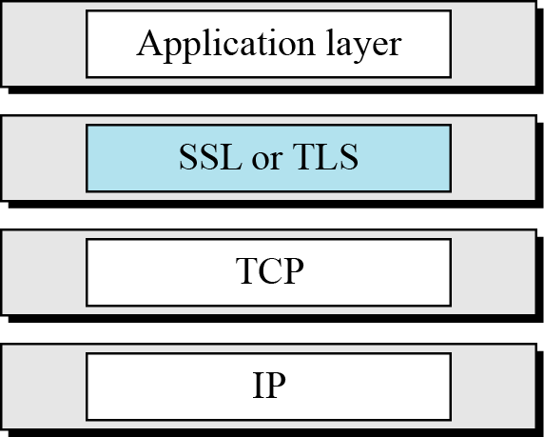
17 Continued
Figure 17.1 Location of SSL and TLS in the Internet model

Slide 14
17-1 SSL ARCHITECTURE
SSL is designed to provide security and compression services to data generated from the application layer.
Topics discussed in this section:
17.1.1 Services 17.1.2 Key Exchange Algorithms 17.1.3 Encryption/Decryption Alogrithms
17.1.4 Hash Algorithms
17.1.5 Cipher Suite
17.1.6 Compression Algorithms
17.1.7 Crypography Parameter Generation
17.1.8 Session and Connections

Slide 15
17.1.1 Services
Fragmentation
Compression
Message Integrity
Confidentiality
Framing

Slide 16
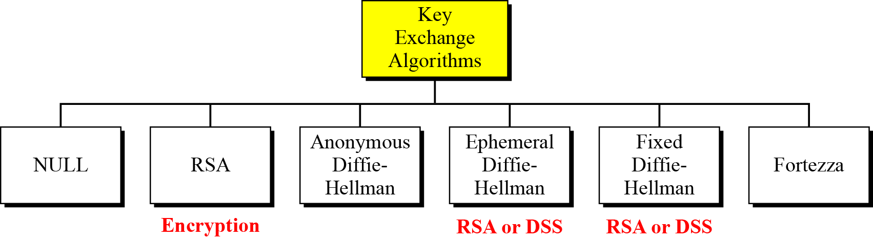
17.1.2 Key Exchange Algorithms
Figure 17.2 Key-exchange methods

Slide 17
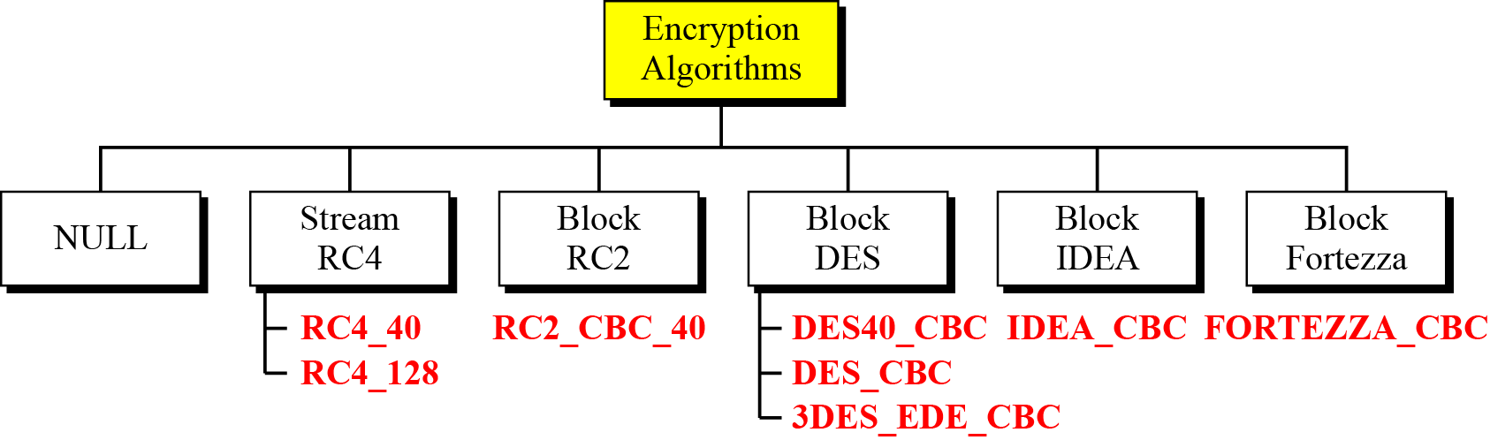
17.1.3 Encryption/Decryption Algorithms
Figure 17.6 Encryption/decryption algorithms

Slide 18
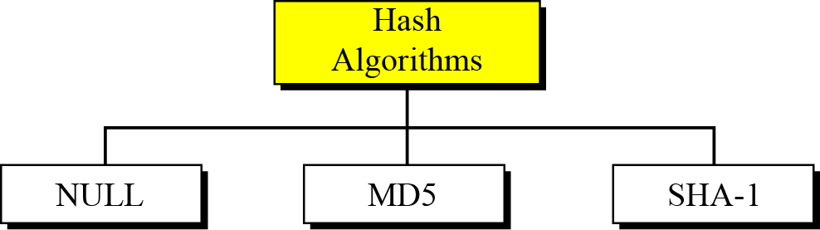
17.1.4 Hash Algorithm
Figure 17.7 Hash algorithms for message integrity

Slide 19
17.1.5 Cipher Suite
The combination of key exchange, hash, and encryption algorithms defines a cipher suite for each SSL session.

Slide 20
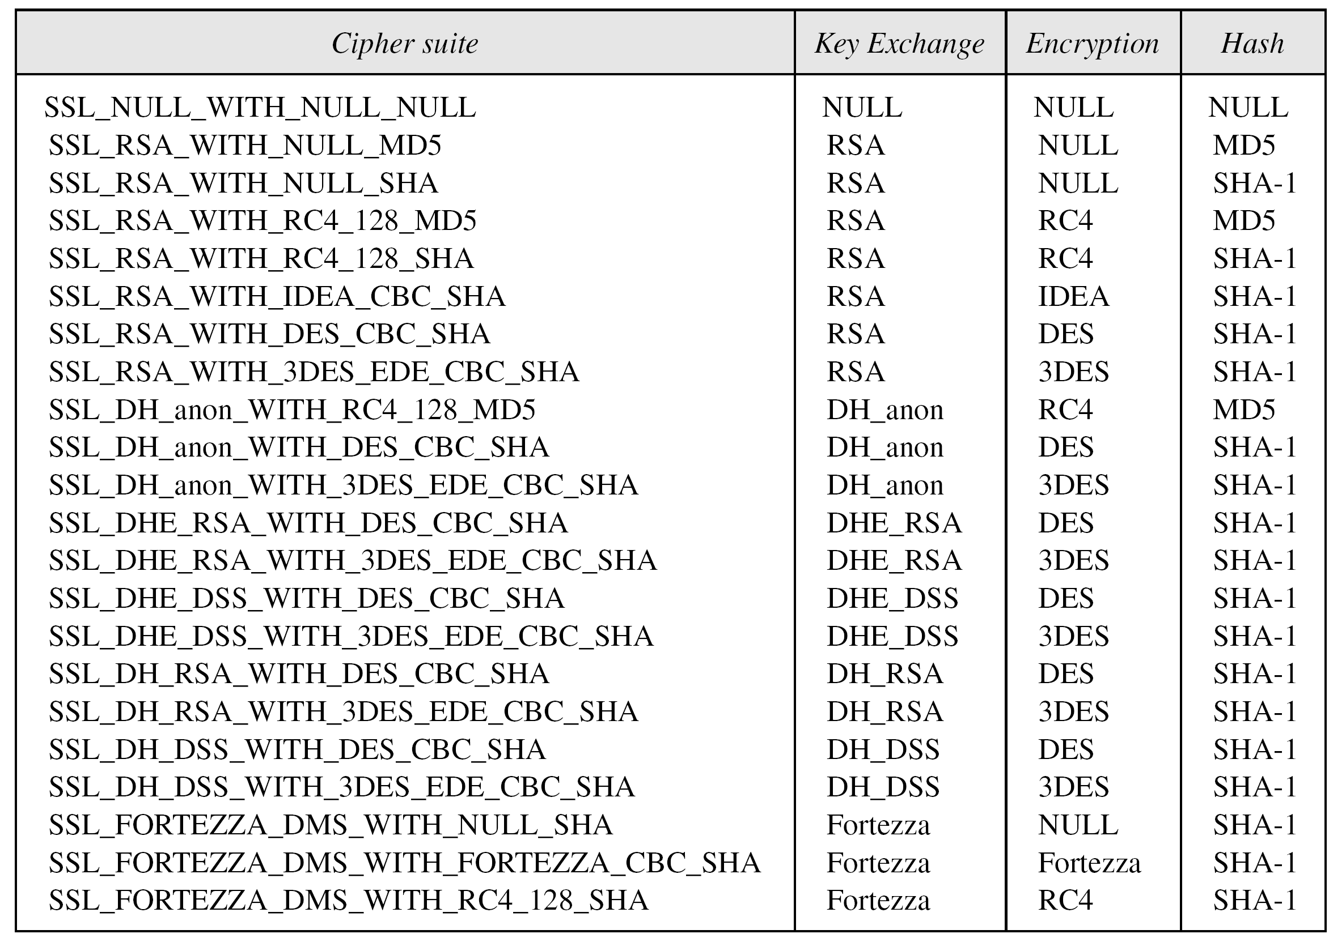
17.1.5 Continued
Table 17.1 SSL cipher suite list

Slide 21
17.1.6 Compression Algorithms
Compression is optional in SSLv3. No specific compression algorithm is defined for SSLv3. Therefore, the default compression method is NULL.

Slide 22
17-2 Four Protocols
We have discussed the idea of SSL without showing how SSL accomplishes its tasks. SSL defines four protocols in two layers, as shown in Figure 17.12.
Topics discussed in this section:
17.2.1 Handshake Protocol
17.2.2 ChangeCipher Spec Protocol 17.2.3 Alert Protocol
17.2.4 Record Protocol

Slide 23
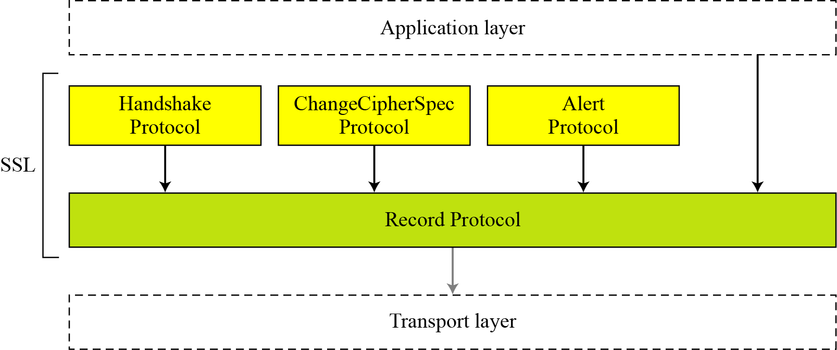
17.2. Continued
Figure 17.12 Four SSL protocols

Slide 24
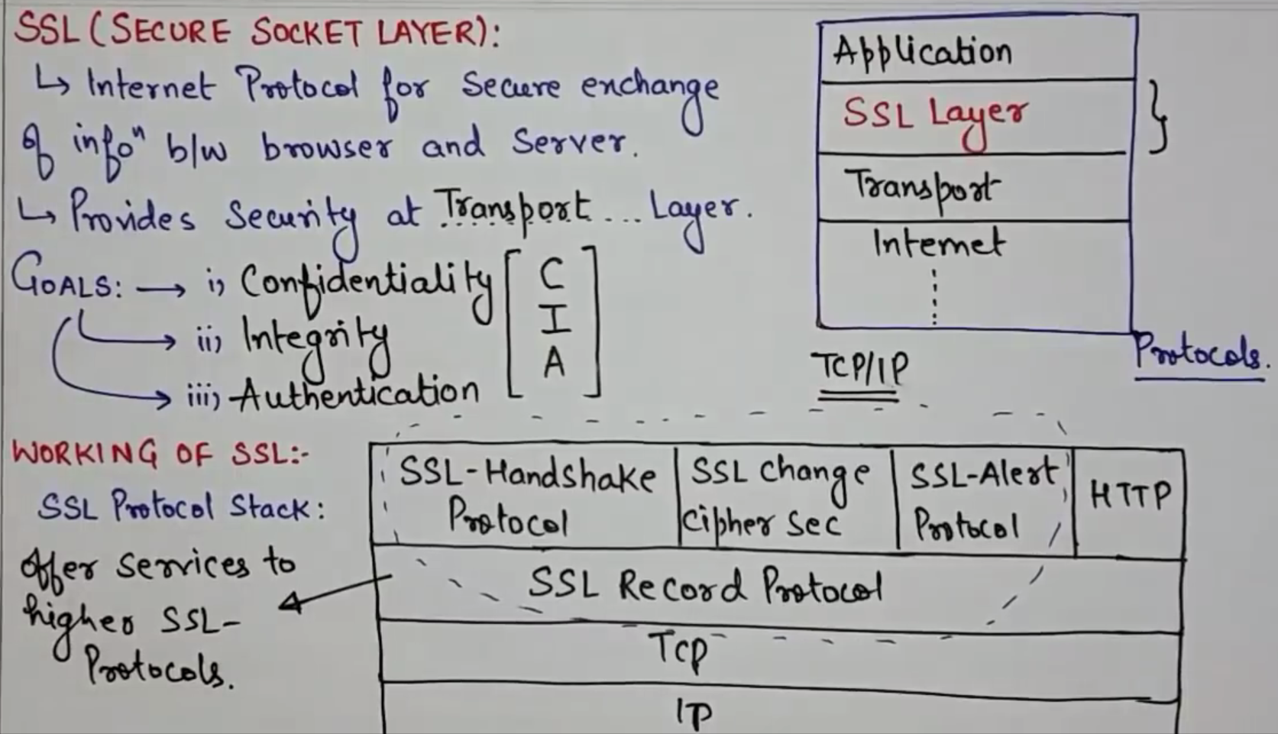

Slide 25
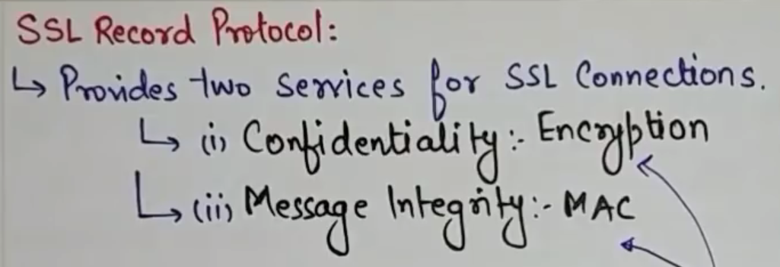

Slide 26
17.1.1 Services
Fragmentation
Compression
Message Integrity
Confidentiality
Framing

Slide 27
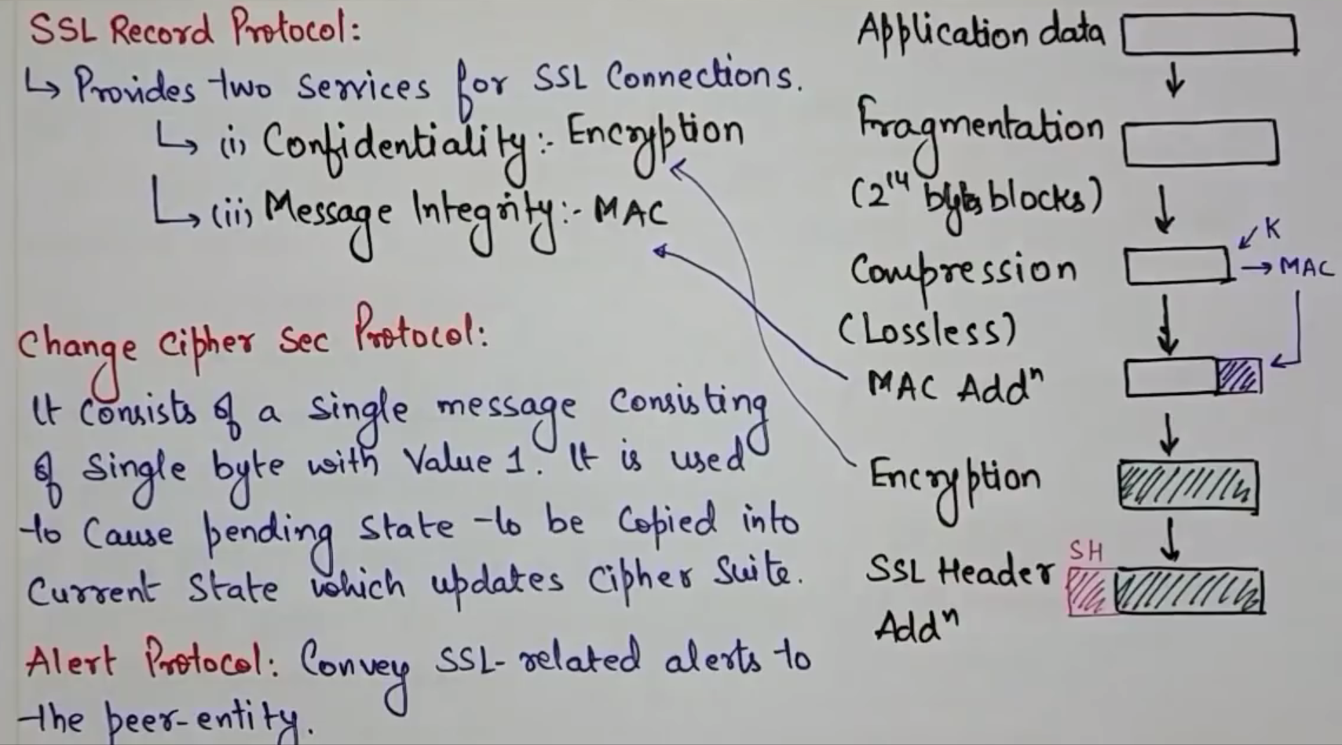

Slide 28
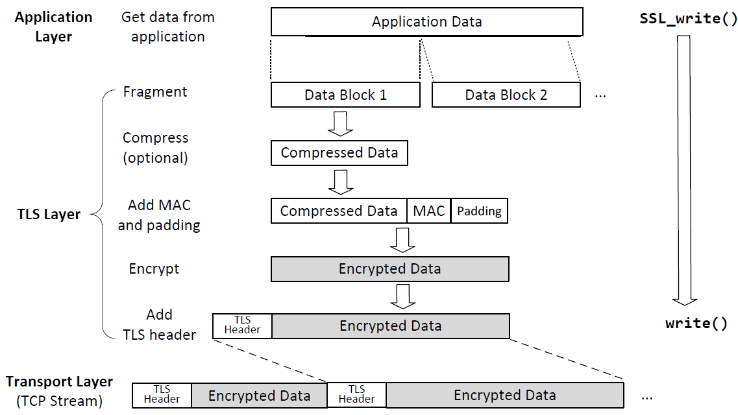
Sending Data with the TLS/SSL Record Protocol
Notes:
Applications invoke SSL_write() to send data over TLS.
This API breaks data into blocks and generates MAC for each block before encrypting the block
TLS puts the encrypted block into the payload field of the TLS record, and gives it to the transport layer for transmission

Slide 29
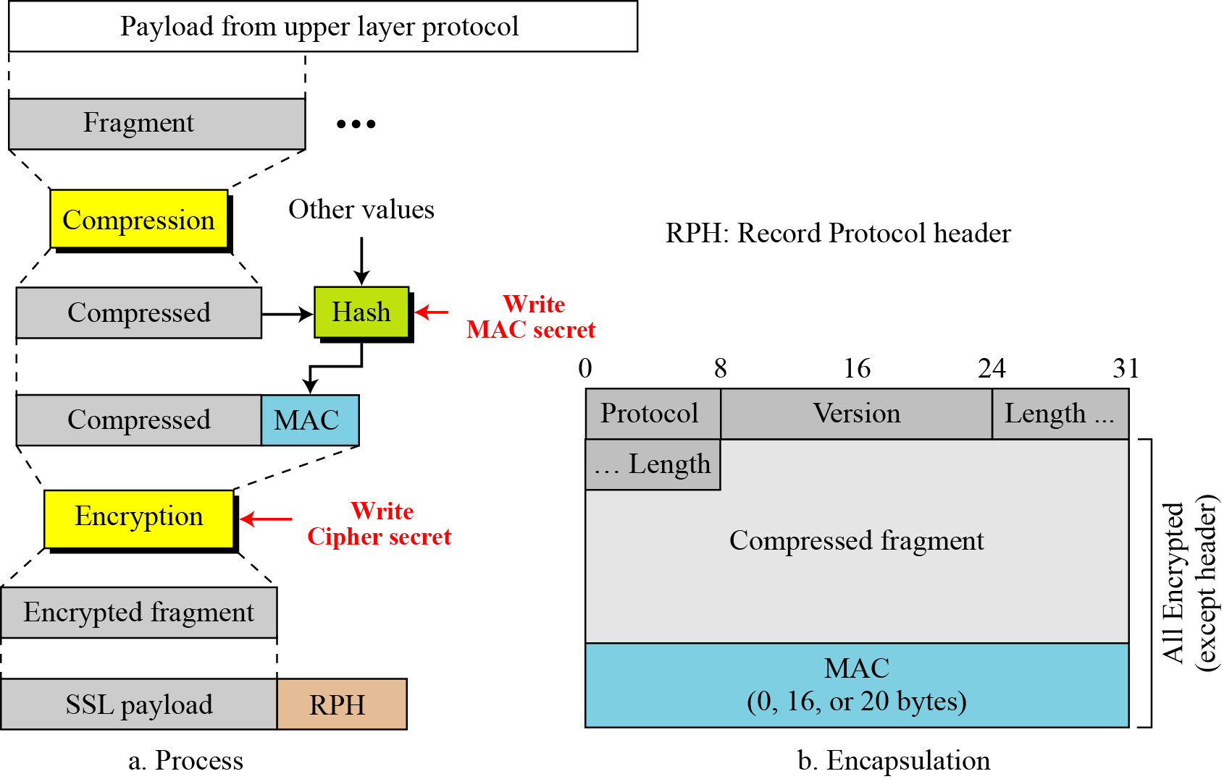
17.2.4 Record Protocol
Figure 17.21 Processing done by the Record Protocol

Slide 30
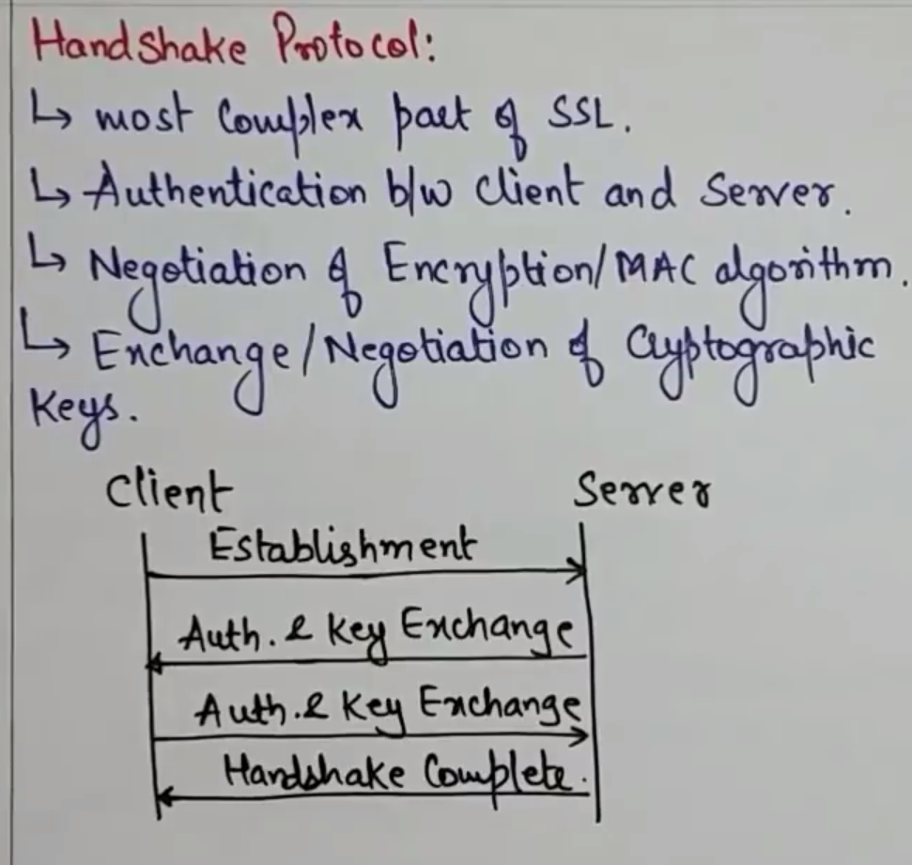

Slide 31
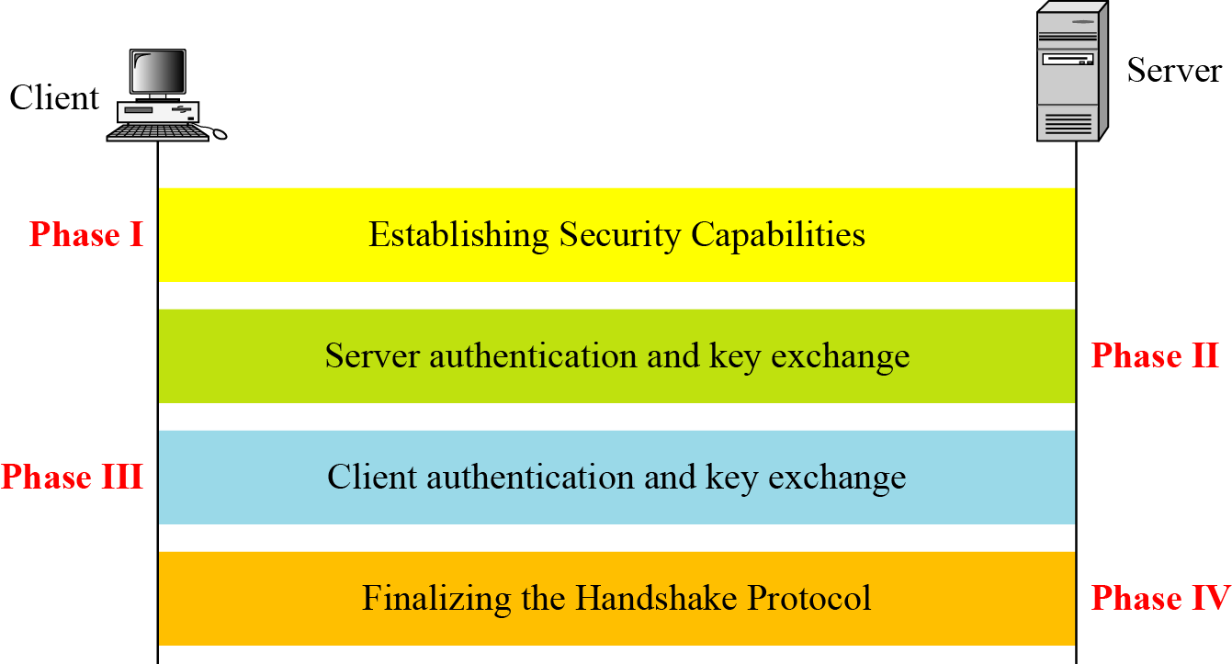
17.2.1 Handshake Protocol
Figure 17.13 Handshake Protocol

Slide 32
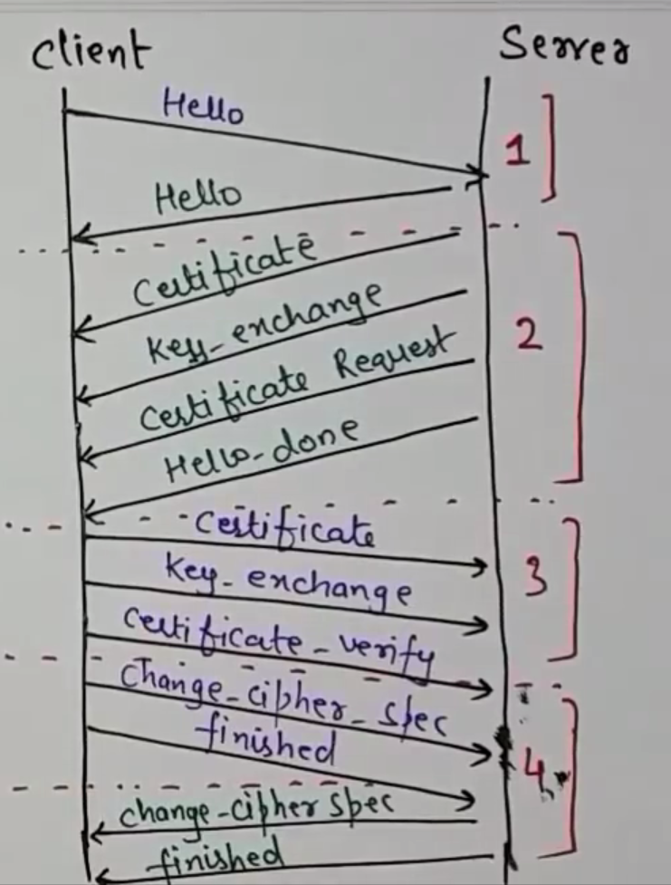

Slide 33
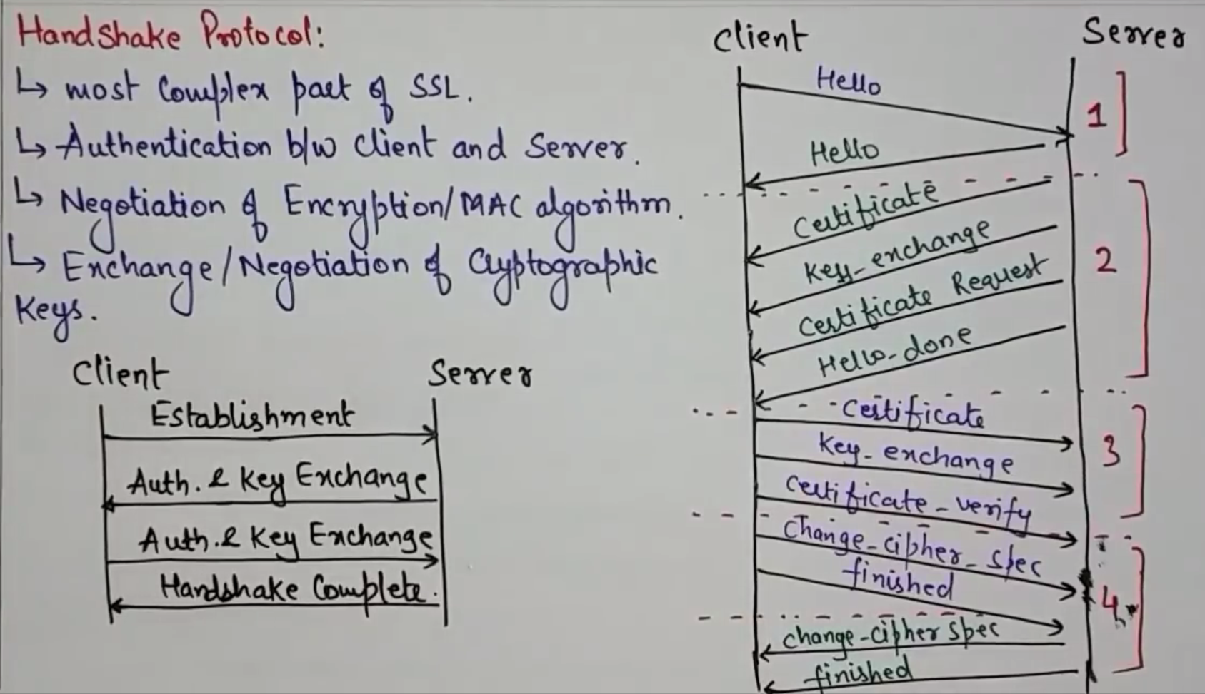

Slide 34
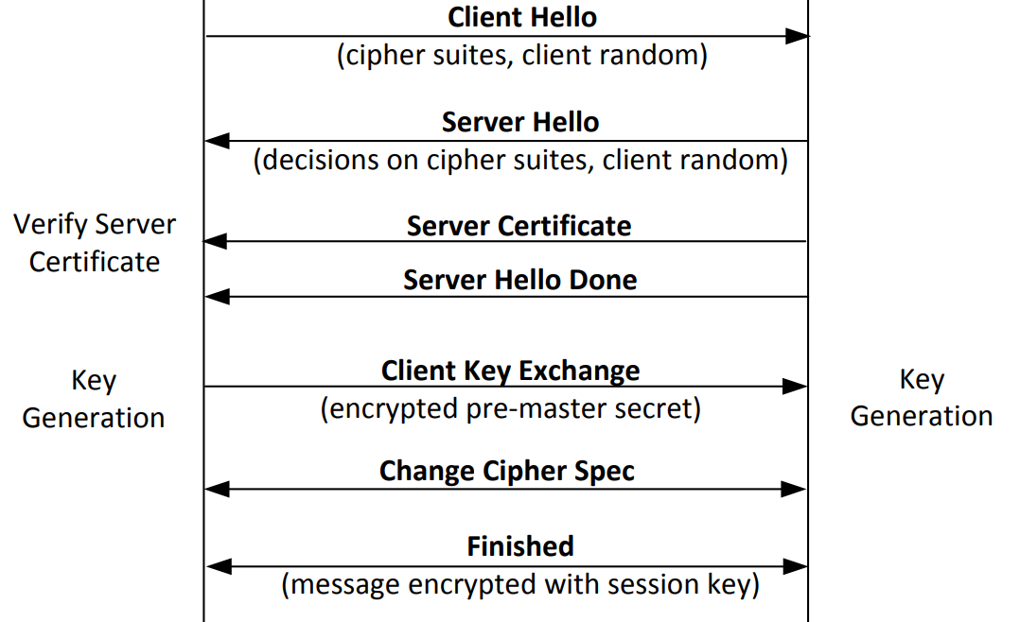
TLS/SSL Handshake Protocol
Notes:
Explanation in further slides

Slide 35
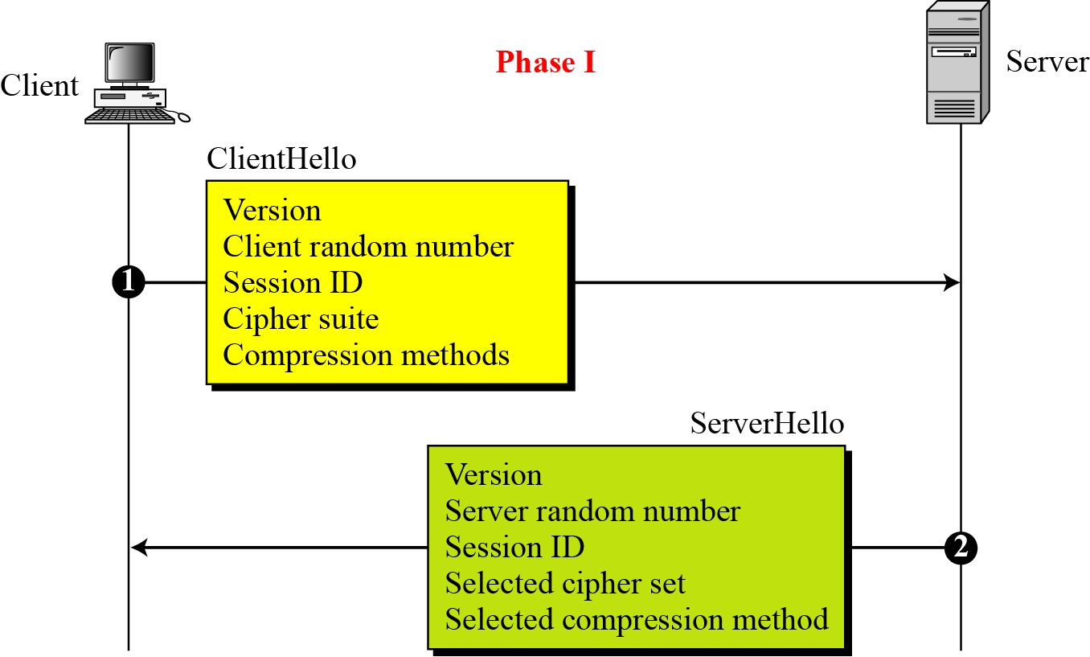
17.2.1 Continued
Figure 17.14 Phase I of Handshake Protocol

Slide 36

17.2.1 Continued
Note
After Phase I, the client and server know the following:
❏ The version of SSL
❏ The algorithms for key exchange, message authentication, and encryption
❏ The compression method
❏ The two random numbers for key generation

Slide 37
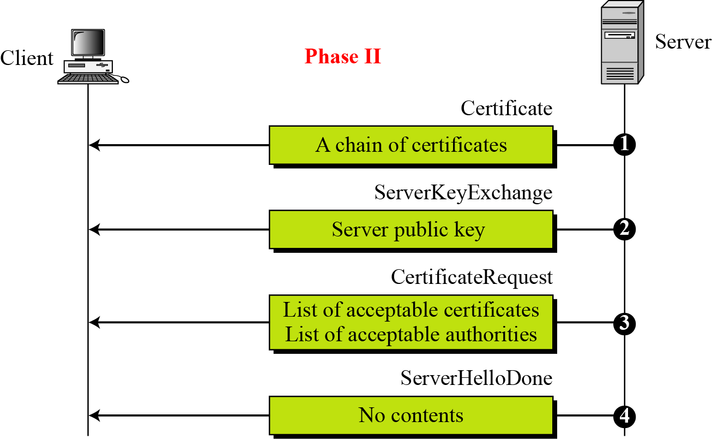
17.2.1 Continued
Figure 17.15 Phase II of Handshake Protocol

Slide 38
17.2.1 Continued
Note
After Phase II,
❏ The server is authenticated to the client.
❏ The client knows the public key of the server if required.

Slide 39
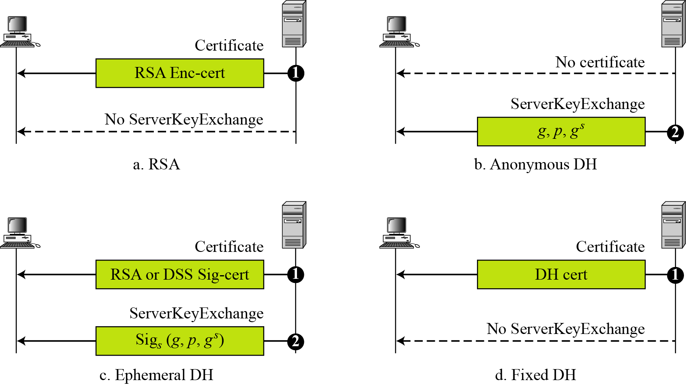
17.2.1 Continued
Figure 17.16 Four cases in Phase II

Slide 40
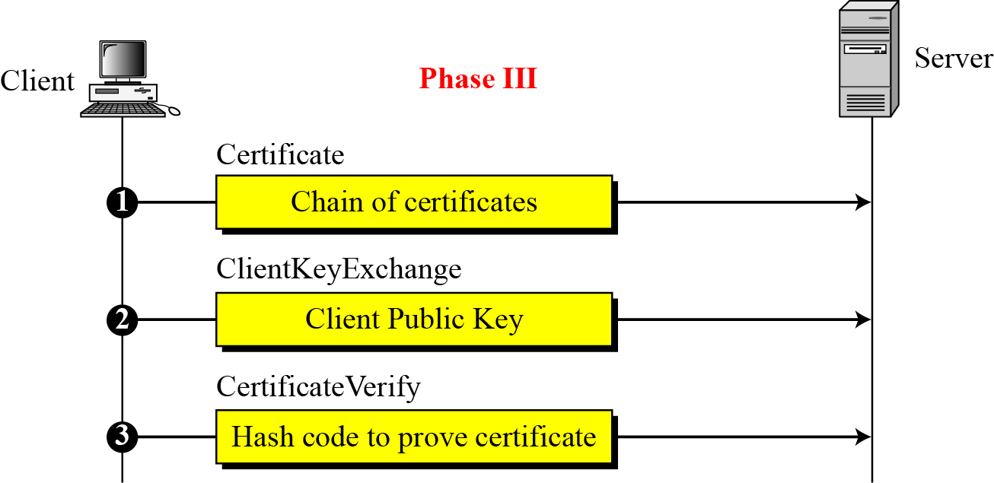
17.2.1 Continued
Figure 17.17 Phase III of Handshake Protocol

Slide 41
17.2.1 Continued
Note
After Phase III,
❏ The client is authenticated for the server.
❏ Both the client and the server know the pre-master secret.

Slide 42
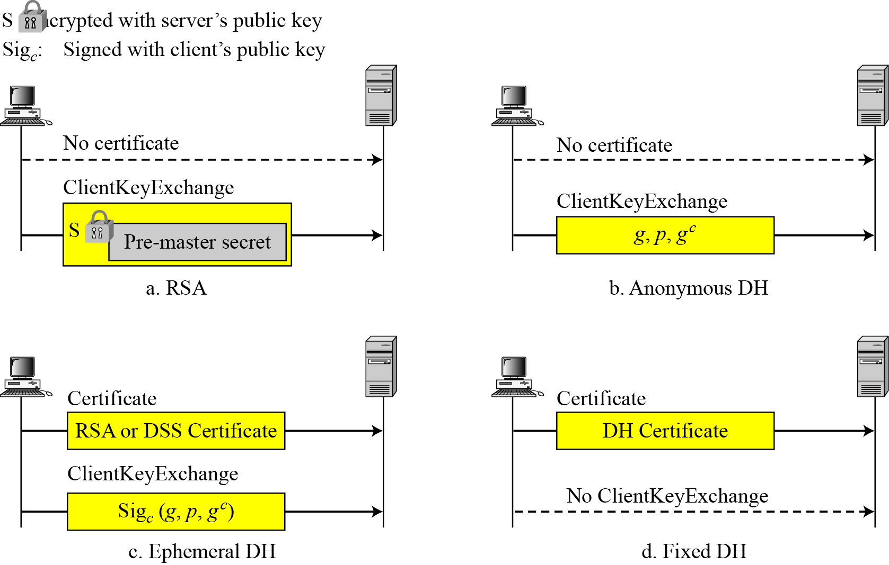
17.2.1 Continued
Figure 17.18 Four cases in Phase III

Slide 43
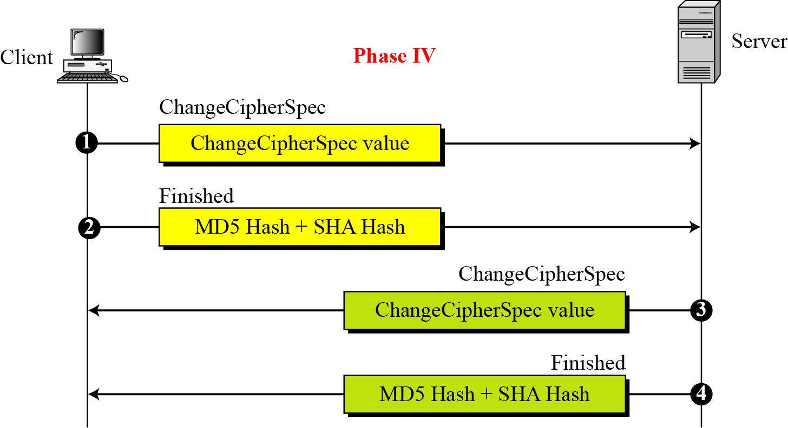
17.2.1 Continued
Figure 17.19 Phase IV of Handshake Protocol

Slide 44
17.2.1 Continued
Note
After Phase IV, the client and server are ready to exchange data.

Slide 45
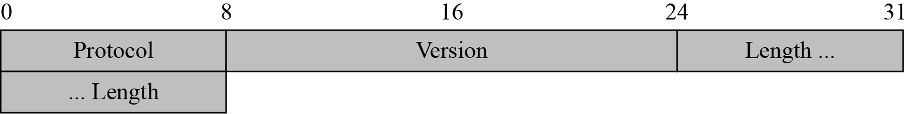
17.3 Continued
Figure 17.23 Record Protocol general header

Slide 46
17.1.6 Compression Algorithms
Compression is optional in SSLv3. No specific compression algorithm is defined for SSLv3. Therefore, the default compression method is NULL.

Slide 47
17-3 SSL MESSAGE FORMATS
As we have discussed, messages from three protocols and data from the application layer are encapsulated in the Record Protocol messages.
Topics discussed in this section:
17.3.1 ChangeCipherSpec Protocol
17.3.2 Alert Protocol 17.3.3 Handshake Protocol 17.3.4 Application Data

Slide 48
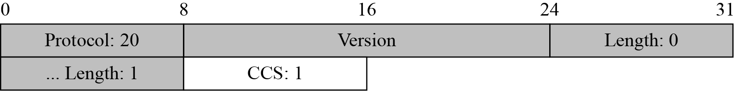
17.3.1 ChangeCipherSpec Protocol
Figure 17.24 ChangeCipherSpec message

Slide 49
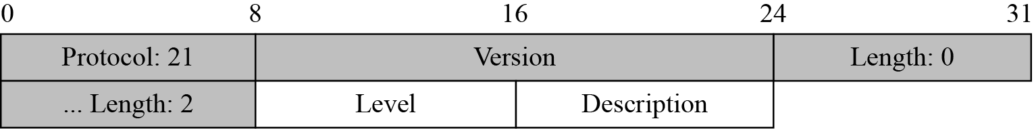
17.3.2 Alert Protocol
Figure 17.25 Alert message

Slide 50
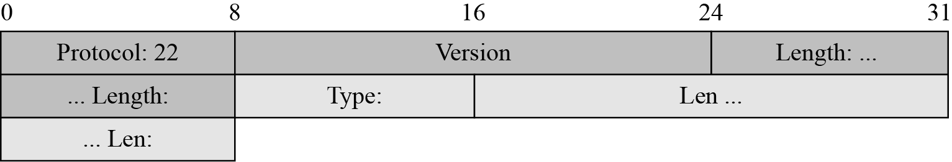
17.3.3 Handshake Protocol
Figure 17.26 Generic header for Handshake Protocol

Slide 51
17.3.3 Continued
Table 17.5 Types of Handshake messages

Slide 52
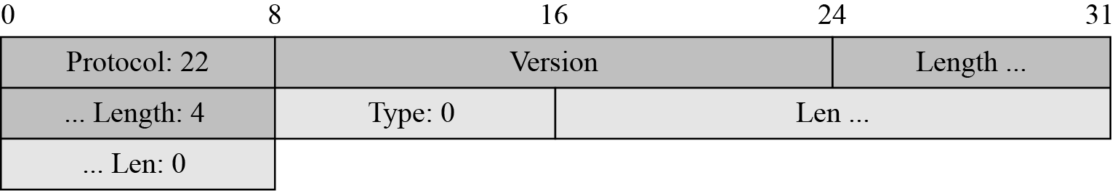
17.3.3 Continued
Figure 17.27 Virtual tributary types

Slide 53
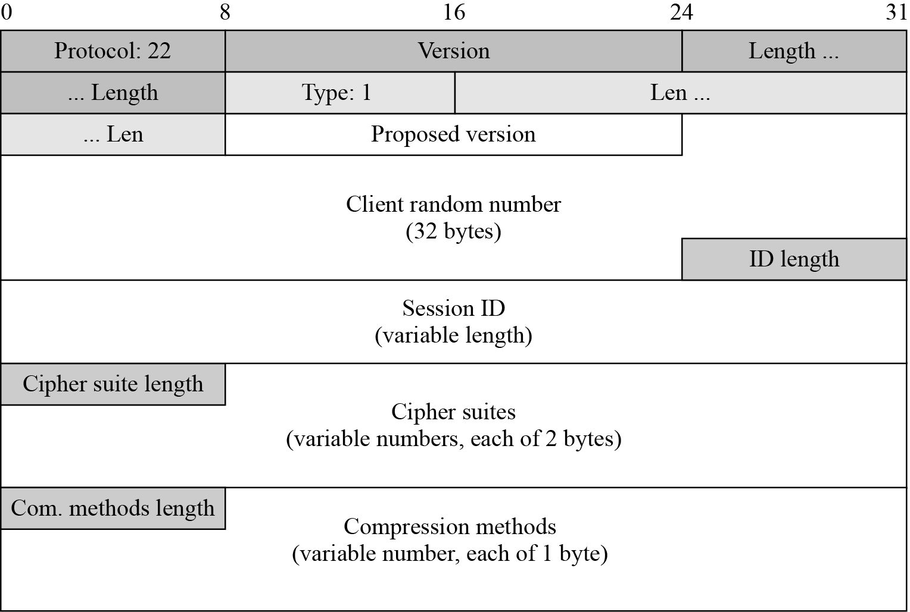
17.3.3 Continued
Figure 17.28 ClientHello message

Slide 54
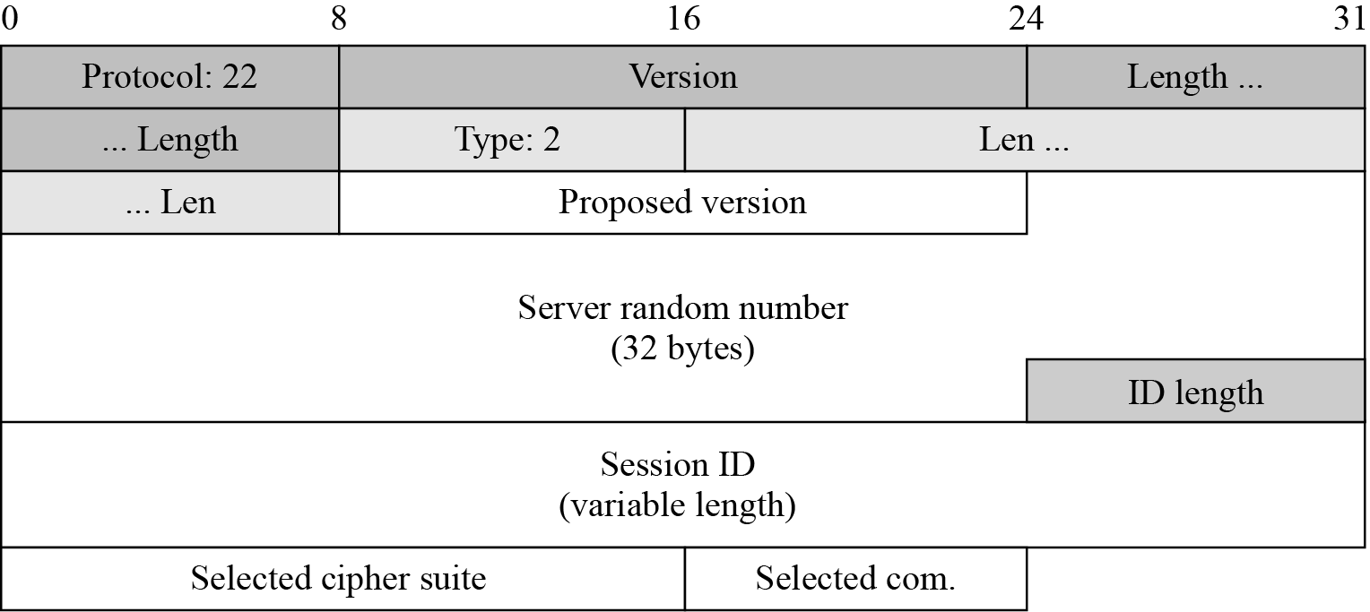
17.3.3 Continued
Figure 17.29 ServerHello message

Slide 55
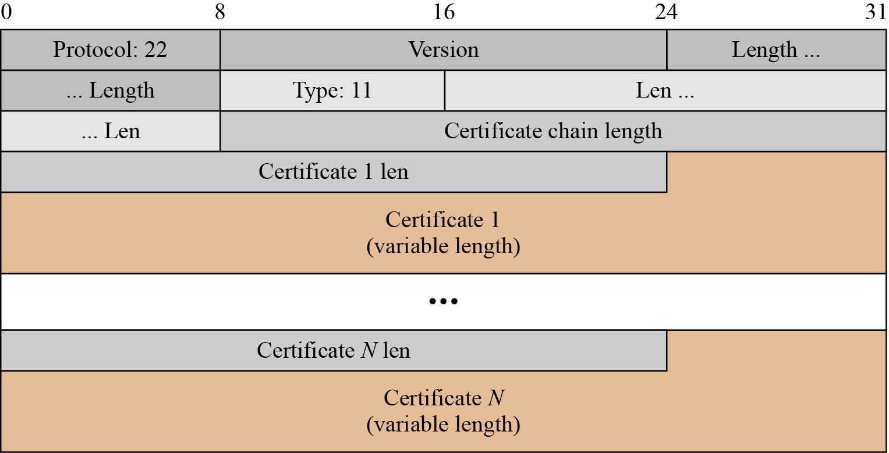
17.3.3 Continued
Figure 17.30 Certificate message

Slide 56
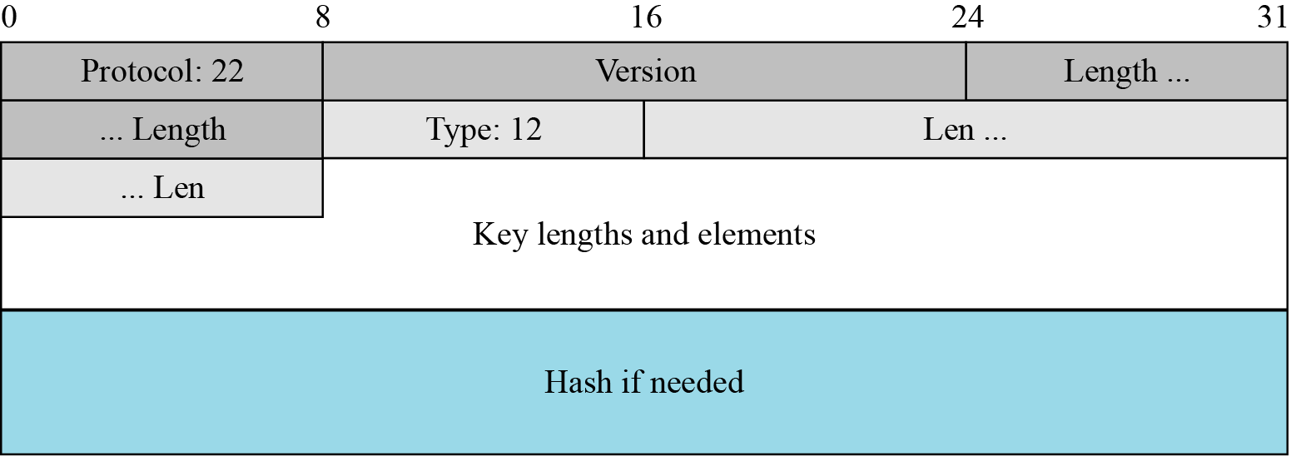
17.3.3 Continued
Figure 17.31 ServerKeyExchange message

Slide 57
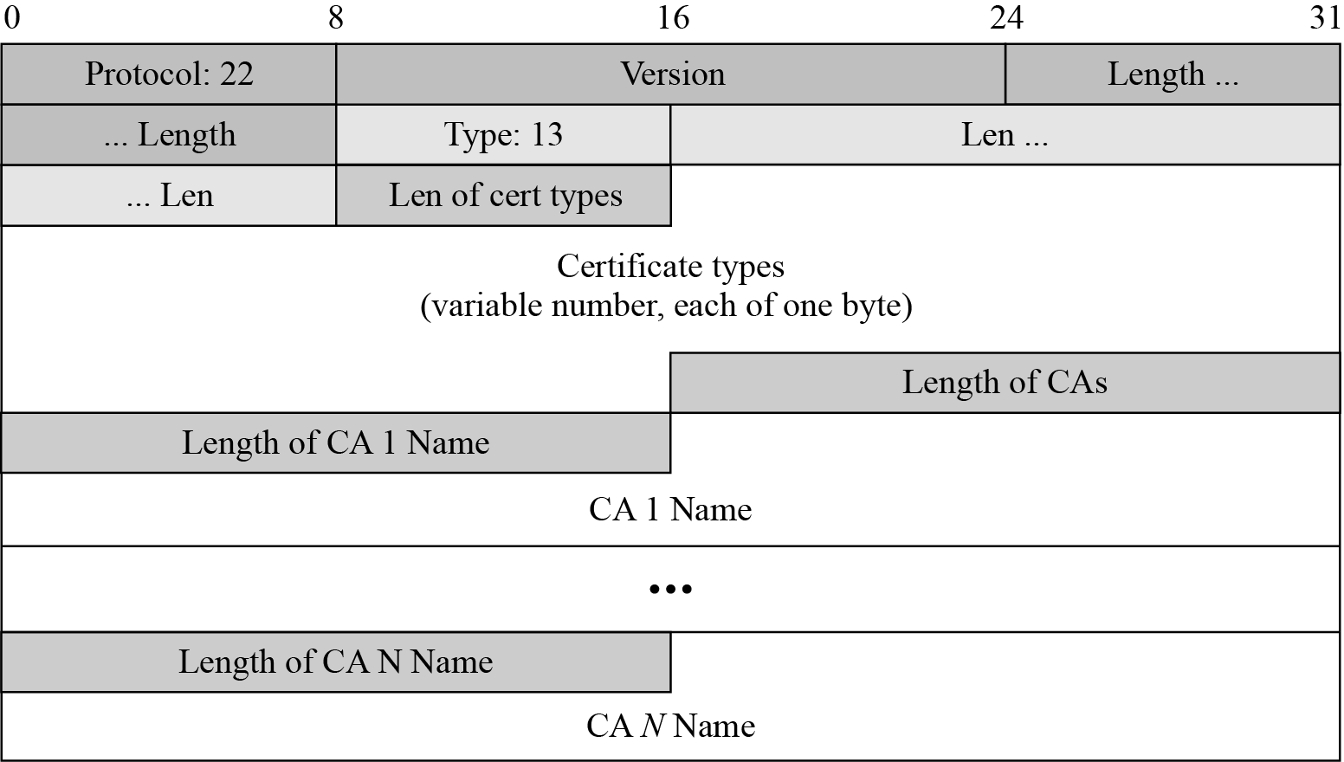
17.3.3 Continued
Figure 17.32 CertificateRequest message

Slide 58
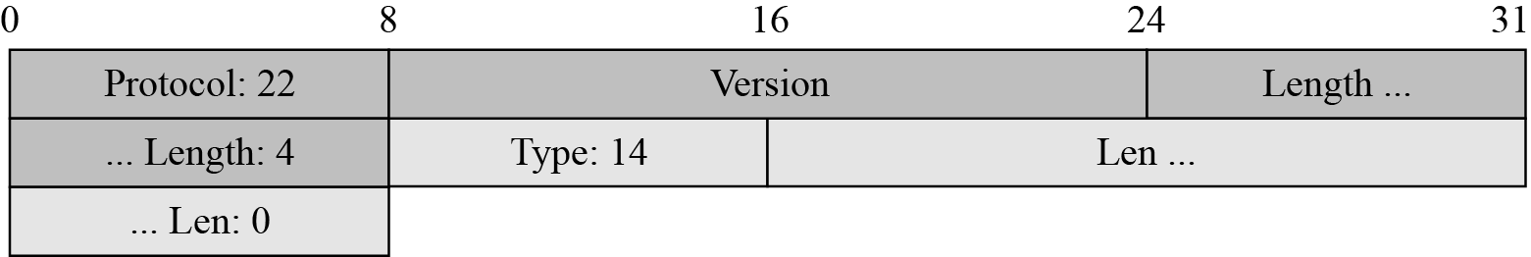
17.3.3 Continued
Figure 17.33 ServerHelloDone message

Slide 59
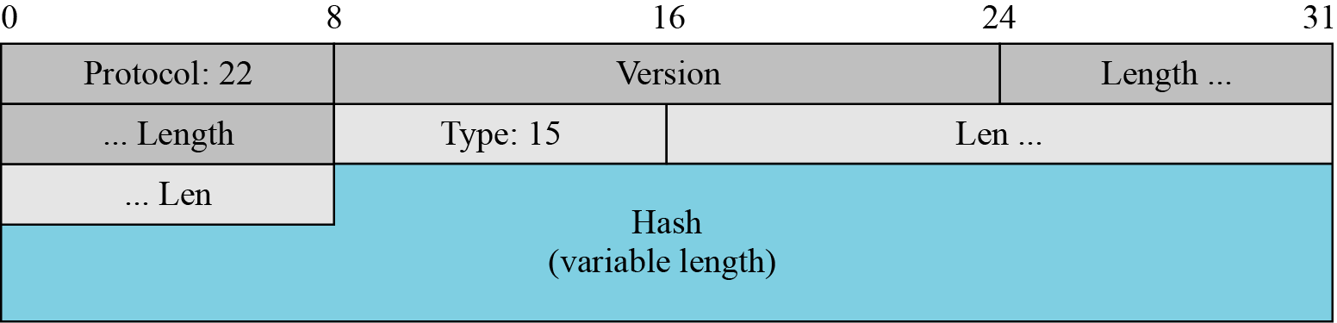
17.3.3 Continued
Figure 17.34 CertificateVerify message

Slide 60
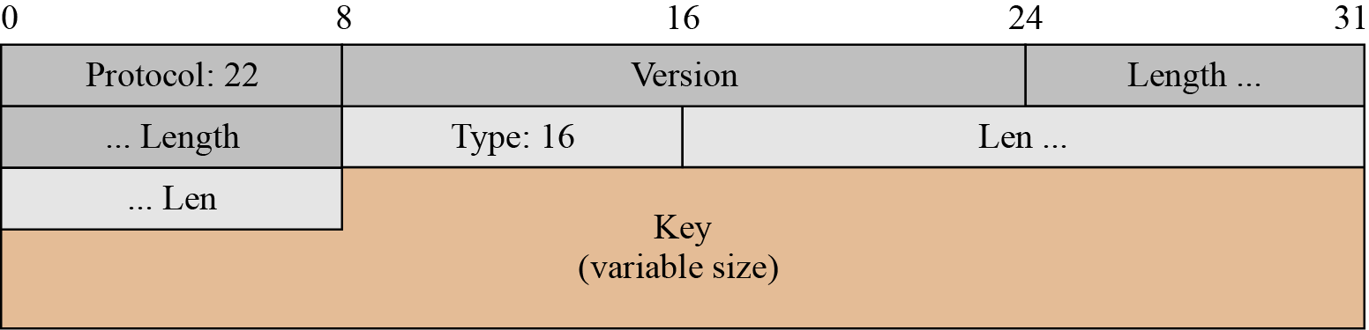
17.3.3 Continued
Figure 17.36 ClientKeyExchange message

Slide 61
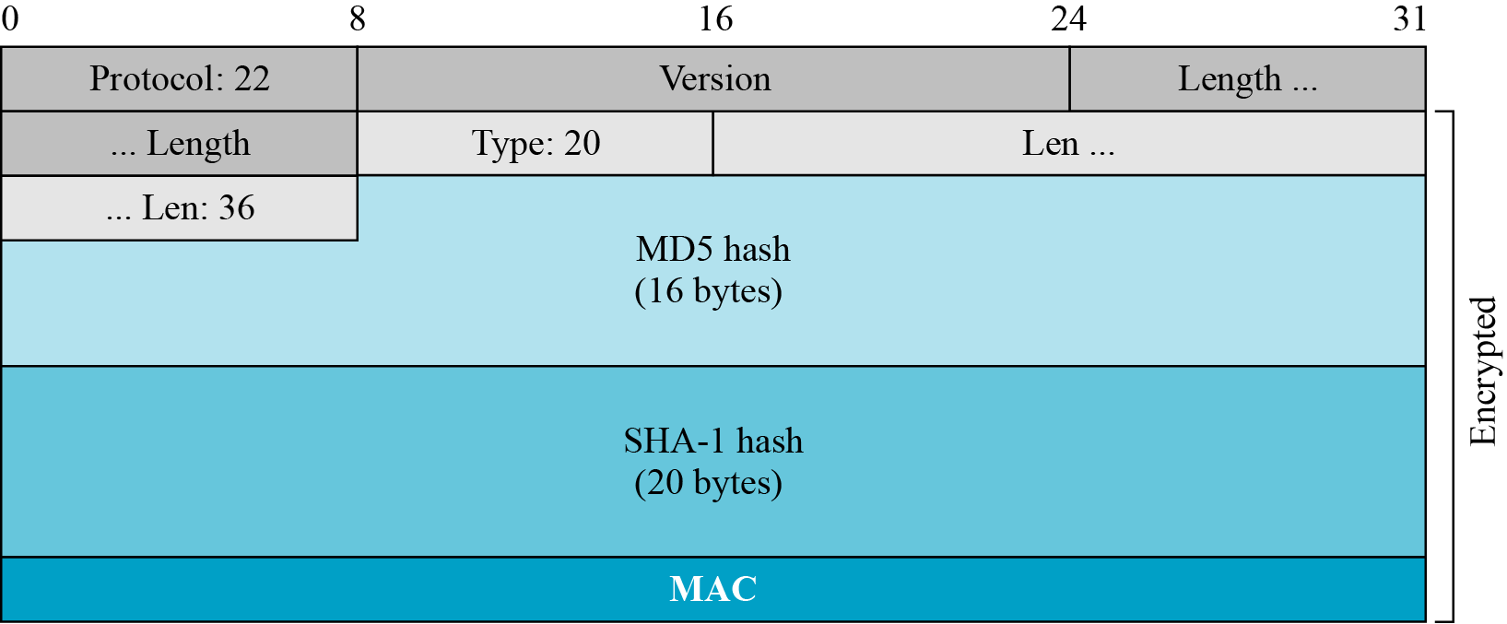
17.3.3 Continued
Figure 17.37 Finished message

Slide 62
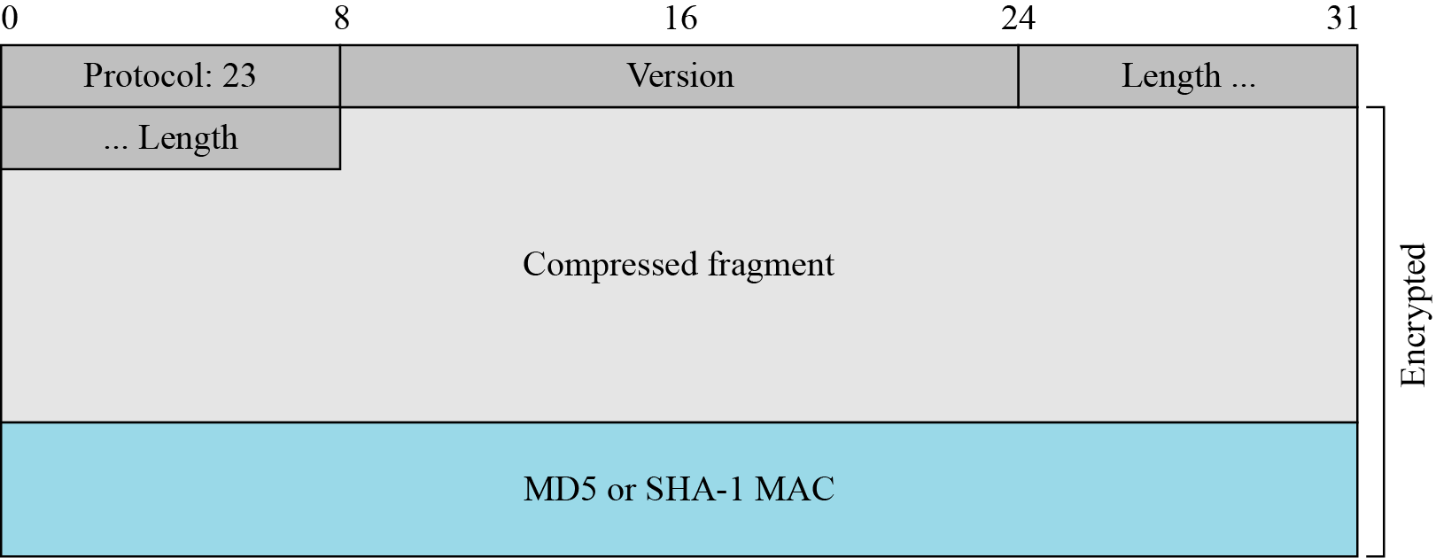
17.3.3 Application Data
Figure 17.39 Record Protocol message for application data

Slide 63
17-4 Transport Layer Security (TLS)
The Transport Layer Security (TLS) protocol is the IETF standard version of the SSL protocol. The two are very similar, with slight differences.
Topics discussed in this section:
17.4.1 Version 17.4.2 Cipher Suite 17.4.3 Generation of Cryptographic Secrets
17.4.4 Alert Protocol 17.4.5 Handshake Protocol 17.4.6 Record Protocol

Slide 64
17.4.1 Version
The first difference is the version number (major and minor). The current version of SSL is 3.0; the current version of TLS is 1.0. In other words, SSLv3.0 is compatible with TLSv1.0.

Slide 65
17.4.2 Cipher Suite
Another minor difference between SSL and TLS is the lack of support for the Fortezza method. TLS does not support Fortezza for key exchange or for encryption/decryption. Table 17.6 shows the cipher suite list for TLS (without export entries).

Slide 66
17.4.2 Continued
Table 17.6 Cipher Suite for TLS

Slide 67
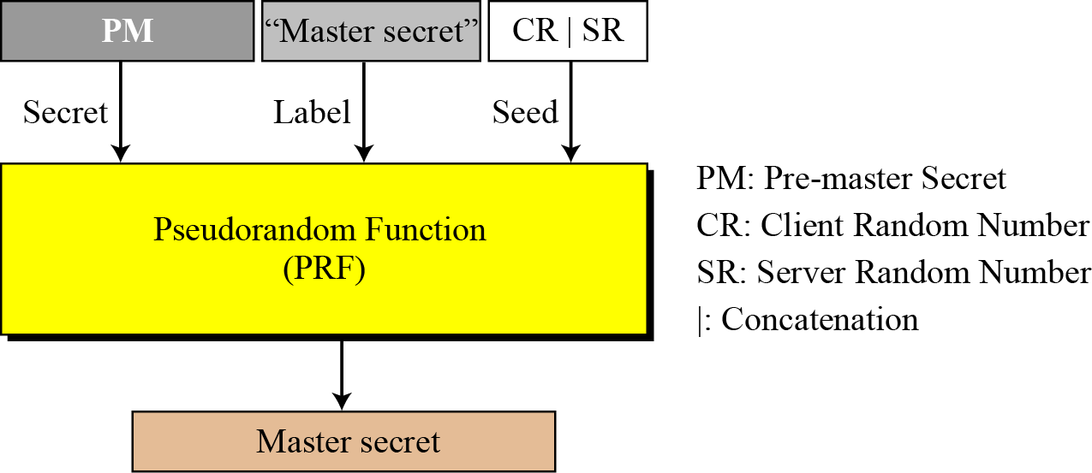
17.4.3 Continued
Figure 17.42 Master secret generation

Slide 68
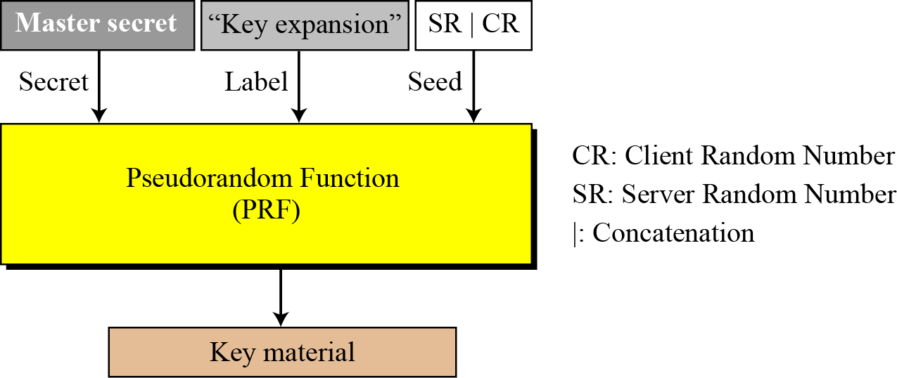
17.4.3 Continued
Figure 17.43 Key material generation

Slide 69
17.4.4 Alert Protocol
TLS supports all of the alerts defined in SSL except for NoCertificate. TLS also adds some new ones to the list. Table 17.7 shows the full list of alerts supported by TLS.

Slide 70
TLS Handshake
Before a client and server can communicate securely, several things need to be set up first:
Encryption algorithm and key
MAC algorithm
Algorithm for key exchange
These cryptographic parameters need to be agreed upon by the client and server
This is the primary purpose of the handshake protocol

Slide 71
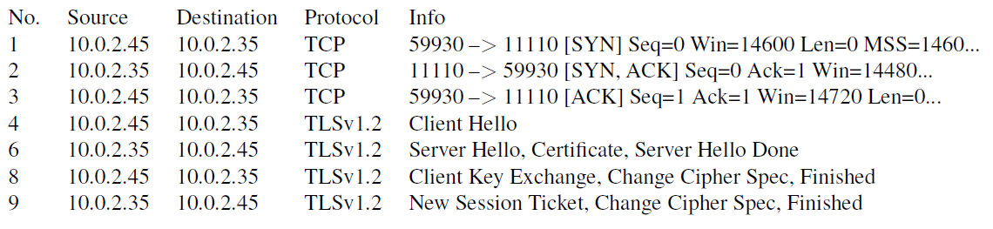
Network Traffics During TLS Handshake
Since TLS runs top of TCP, a TCP connection needs to be established before the handshake protocol. This is how the packet exchange looks between a client and server during a TLS handshake protocol captured using Wireshark:

Slide 72
Certificate Verification
The client first does a validation check of the certificate
Check expiration date, signature validity, etc.
Hostname and certificate’s common name match
The client needs to have the singing CA’s public-key certificate.
Notes:
Client programs, such as browsers, need to load a list of trusted CA certificated beforehand, or they will not be able to verify any certificate
If the signing CA is on the list, the certificate can be directly verified

Slide 73
Key Generation and Exchange
Although public-key algorithms can be used to encrypt data, it is much more expensive than secret-key algorithms.
TLS uses PKI for key exchange.
After that, server and client switch to secret-key encryption algorithm (Symmetric )
The entire key generation consists of three steps:
Step 1: Generating pre-master secret
Step 2: Generating master secret
Step 3: Generating session keys

Slide 74
What is a session key?
A session key is any encryption key used to symmetrically encrypt one communication session only. In other words, it's a temporary key that is only used once, during one stretch of time, for encrypting and decrypting data; future conversations between the two parties would be encrypted with different session keys. A session key is like a password that someone resets every time they log in.
In SSL/TLS, the two communicating parties (the client and the server) generate 4 session keys at the start of any communication session, during the TLS handshake. The official RFC for TLS does not actually call these keys "session keys", but functionally that's exactly what they are.
What is a session?
A session is essentially a conversation. A session takes place over a network, and it begins when two devices acknowledge each other and open a virtual connection. It ends when the two devices have obtained the information they need from each other and send "finished" messages, terminating the connection, much like if two people are texting each other, and they close the conversation by saying, "Talk to you later." The connection can also time out due to inactivity, like if two people are texting and simply stop responding to each other.
A session can either be a set period of time, or it can last for as long as the two parties are communicating. If the former, the session will expire after a certain amount of time; in the context of TLS encryption, the two devices would then have to exchange information and generate new session keys to reopen the connection.
Notes:
What is a cryptographic key?
In encryption, a key is a string of data that is used to alter messages so that they become encrypted – in other words, so that the data appears randomized or scrambled. A key is also used for decrypting the data, or translating it from its scrambled form to its original form. (See What is a cryptographic key? to learn more.)
What is symmetric encryption? What is asymmetric encryption?
In symmetric encryption, the exact same key is used on both sides of a conversation, for both encrypting and decrypting. In a session that uses symmetric encryption, multiple keys can be used, but a message that is encrypted with one key is decrypted with that same key.
In asymmetric encryption, there are two keys, and data that is encrypted with one key can only be decrypted with the other key – unlike in symmetric encryption, when the same key both encrypts and decrypts. This is also known as public key encryption, because one of the keys is shared publicly.

Slide 75
Does HTTPS use symmetric or asymmetric encryption?
HTTPS, which is HTTP with the TLS encryption protocol, uses both types of encryption. All communications over TLS start with a TLS handshake.
Asymmetric encryption is crucial for making the TLS handshake work.
During the course of a TLS handshake, the two communicating devices will establish the four session keys, and these will be used for symmetric encryption for the rest of the session.
Usually, the two communicating devices are a client, or a user device like a laptop or a smartphone, and a server, which is any web server that hosts a website. (For more, see What is the client-server model?)

Slide 76
How does a TLS handshake work?
During a TLS handshake, both client and server send each other random data, which they use to make calculations separately and then derive the same session keys.
Three kinds of randomly generated data are sent from one side to the other:
The "client random": This is a random string of bytes that the client sends to the server.
The "server random": This is similar to the client random, except that the server sends it to the client.
The "premaster secret": This is yet another string of data. In some versions of the TLS handshake, the client generates this and sends it to the server encrypted with the public key; in other versions, the client and server generate the premaster secret on their own, using agreed-upon algorithm parameters to arrive at the same result.
The TLS handshake uses asymmetric encryption either to hide the server random from attackers (by encrypting it with a private key), or for allowing the server to digitally "sign" one of its messages so that the client knows the server is who it claims to be (just as a signature helps verify someone's identity in real life). The server encrypts some data with the private key, and the client uses the public key to decrypt it, proving that the server has the correct key and is legitimate.

Slide 77
What is the 'master secret' in a TLS handshake?
The master secret is the final result from combining the client random, the server random, and the premaster secret via an algorithm.
The client and the server each have those three messages, so they should arrive at the same result for the master secret.
The client and server then use the master secret to calculate several session keys for use in that session only – 4 session keys, to be precise.

Slide 78
What 4 session keys are generated from the master secret in a TLS handshake?
The 4 kinds of session keys created in each TLS handshake are:
1) The "client write key"
2) The "server write key"
3) The "client write MAC key"
4) The "server write MAC key“
1) The client write key is the key that the client uses to encrypt its messages. The client write key is a symmetric key, and both the client and the server have it. This enables the server to decrypt messages from the client using the same key.
2) The server write key is just like the client write key, except on the server side. To summarize: Messages from client to server are encrypted with the client write key, and the server uses the client write key to decrypt them.
Messages from server to client are encrypted with the server write key, and the client uses the server write key to decrypt them. (This whole process is handled by the client device or browser; the users themselves don't have to do any of this encrypting or decrypting.)

Slide 79
The MAC, or message authentication code, keys are used to digitally sign messages.
The server signs its messages with the 3) server write MAC key, and when the client receives the message, it can check the MAC key used against its own record of the server MAC key to make sure it's legitimate. The 4) client signs its messages with the client write MAC key.
A set of 4 completely new session keys gets created with every new communication session and new TLS handshake.
There will be a different client write key, server write key, and so on, but those 4 types of keys get created every time.

Slide 80
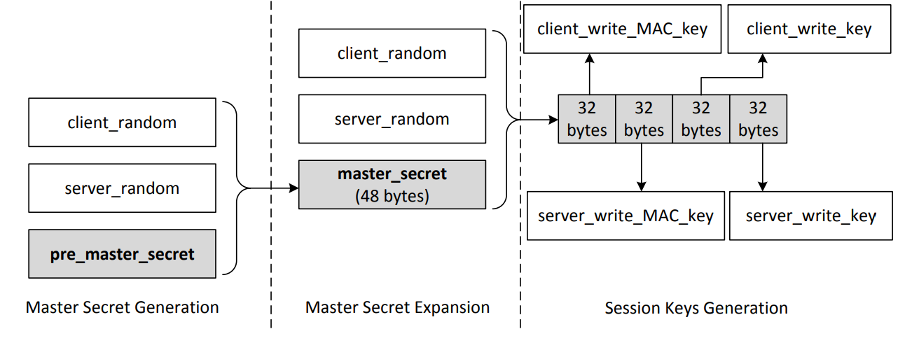
Key Generation and Exchange
These keys are used to protect an SSL session
Notes:
Pre master secret : The length of the number depends on the key exchange algorithm. Secret is encrypted with the servers public key and sent to the server.
Session keys: the client_write keys are used to secure the data from the client to the server which the server_write keys are used to secure data from the server to the client. The communication is bi-directional so both directions use separate keys.
The figure assumes we are using AES_256_CBC_SHA so each key is 32 bytes long

Slide 81
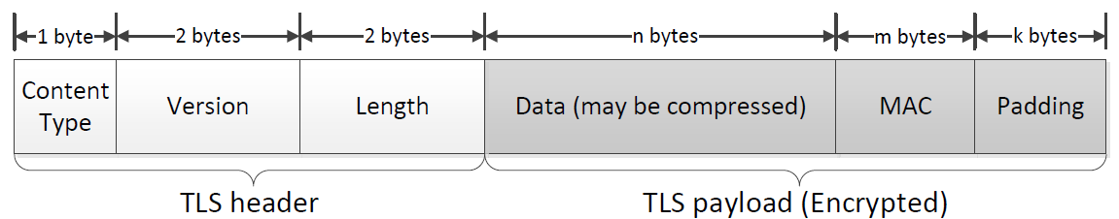
TLS Data Transmission
Once the handshake protocol is finished, client and server can start exchanging data.
Data is transferred using records.
Each record contains a header and a payload
Notes:
In this section, we focus on the application record type, which is used to transfer application data between a client and a server
Content Type: Indicates the type of protocol data carried by current record (handshake, alert, application, heartbeat or ChangeCipherSpec)
Version: This field identifies major and minor version of TLS being used
Length: The length of the payload field.

Slide 82
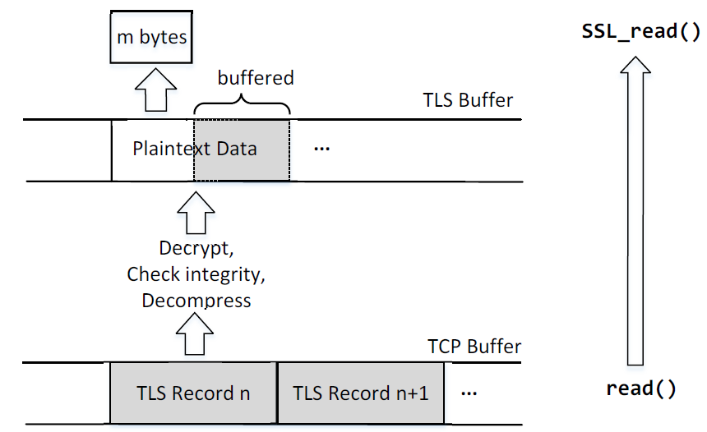
Receiving Data with the TLS Record Protocol
Notes:
Applications invoke SSL_read() to read data over TLS which calls the system read() to read one or multiple records from the TCP stream
After reading, the packet is decrypted, MAC is verified, data is decompressed (if needed) and then data is given to the application
When SSL_read() is called and TLS buffer is empty:
one TLS record is retrieved from the TCP buffer and processed
If the number of bytes is not enough to satisfy the request, another TLS record is retrieved.
This will repeat until the request is satisfied or no more data is available
If the total number of processed bytes exceeds the required number, leftover is stored in the TLS buffer for later read requests
When SSL_read() is called and TLS buffer is not empty:
TLS tries to get the requested amount of data from the TLS buffer
If the buffer contains enough data, TLS returns the required amount to the application
If the buffer does not contain enough data, TLS returns all the amount to the application

Slide 83
Integrating SSL/TLS with HTTP ⇒ HTTPS
Few common old concepts:
In computer networking, a proxy server is a server application or appliance that acts as an intermediary for requests from clients seeking resources from servers that provide those resources.
In computer networks, a tunneling protocol is a communications protocol that allows for the movement of data from one network to another. It involves allowing private network communications to be sent across a public network (such as the Internet) through a process called encapsulation.
HTTP tunneling is used to create a network link between two computers in conditions of restricted network connectivity including firewalls, NATs and ACLs, among other restrictions. The tunnel is created by an intermediary called a proxy server which is usually located in a DMZ.
Tunneling can also allow communication using a protocol that normally wouldn’t be supported on the restricted network

Slide 84
In computer networking, a proxy server is a server application or appliance that acts as an intermediary for requests from clients seeking resources from servers that provide those resources.^{[1]} A proxy server thus functions on behalf of the client when requesting service, potentially masking the true origin of the request to the resource server.
Instead of connecting directly to a server that can fulfill a requested resource, such as a file or web page for example, the client directs the request to the proxy server, which evaluates the request and performs the required network transactions. This serves as a method to simplify or control the complexity of the request,^{[2]} or provide additional benefits such as load balancing, privacy, or security. Proxies were devised to add structure and encapsulation to distributed systems

Slide 85
HTTP CONNECT
The CONNECT method converts the request connection to a transparent TCP/IP tunnel, usually to facilitate SSL-encrypted communication (HTTPS) through an unencrypted HTTP proxy.
HTTP CONNECT method:
The most common form of HTTP tunneling is the standardized HTTP CONNECT method.^{[1][2]}
In this mechanism, the client asks an HTTP proxy server to forward the TCP connection to the desired destination.
The server then proceeds to make the connection on behalf of the client. Once the connection has been established by the server, the proxy server continues to proxy the TCP stream to and from the client.
Only the initial connection request is HTTP - after that, the server simply proxies the established TCP connection.
This mechanism is how a client behind an HTTP proxy can access websites using SSL or TLS (i.e. HTTPS).
Proxy servers may also limit connections by only allowing connections to the default HTTPS port 443, whitelisting hosts, or blocking traffic which doesn't appear to be SSL.
Notes:
HTTP tunneling without using CONNECT[edit]
A HTTP tunnel can also be implemented using only the usual HTTP methods as POST, GET, PUT and DELETE. This is similar to the approach used in Bidirectional-streams Over Synchronous HTTP (BOSH).
In this proof-of-concept program , a special HTTP server runs outside the protected network and a client program is run on a computer inside the protected network. Whenever any network traffic is passed from the client, the client repackages the traffic data as a HTTP request and relays the data to the outside server, which extracts and executes the original network request for the client. The response to the request, sent to the server, is then repackaged as an HTTP response and relayed back to the client. Since all traffic is encapsulated inside normal GET and POST requests and responses, this approach works through most proxies and firewalls.

Slide 86
Just for info Read it:
Implementations of proxies
Web proxy servers
Web proxies forward HTTP requests. The request from the client is the same as a regular HTTP request except the full URL is passed, instead of just the path.[17]
GET https://en.wikipedia.org/wiki/Proxy_server HTTP/1.1
Proxy-Authorization: Basic encoded-credentials
Accept: text/html
This request is sent to the proxy server, the proxy makes the request specified and returns the response.
IMP:
HTTP/1.1 200 OK
Content-Type: text/html; charset UTF-8
Some web proxies allow the HTTP CONNECT method to set up forwarding of arbitrary data through the connection; a common policy is to only forward port 443 to allow HTTPS traffic

Slide 87
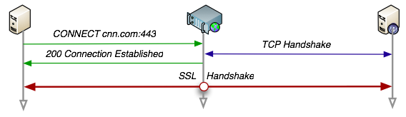
Tunneling SSL over HTTP
First, it is worth recalling that HTTP does allow us to tunnel SSL connections, end-to-end, via an HTTP proxy. This is a little known protocol feature, but an important one for our purposes:
To proxy an HTTPS session the client connects to the proxy by sending a special CONNECT HTTP method, which also includes just the host and the port of the destination.
The proxy authenticates the request, completes the TCP handshake with the specified destination and returns a 200 Connection Established response, after which, it simply becomes a dumb, two-way router.
At this point, the client and the server negotiate the SSL session and start to exchange encrypted data directly through the proxy.
In other words, the proxy only sees encrypted data, and the only thing it knows are the hostnames and the ports of both parties.

Slide 88
This is great, but there is still one problem: the original CONNECT handshake (in green), alongside the host and the port of the destination is sent in clear text.
Even worse, the proxy authentication (if any) is also running over the same insecure channel.
Unfortunately, browsers today do not support secure HTTP proxies! Hence the reason why we've historically resorted to heavyweight SSL VPN's, SOCKS tunnels, and the like.

Slide 89
Integrating SSL/TLS with HTTP ⇒ HTTPS
web proxy
web server
Two complications
Web proxies
solution: browser sends CONNECT domain-name
before client-hello (dropped by proxy)
Virtual hosting
two sites hosted at same IP address.
solution in TLS 1.1: SNI (RFC 4366)
client_hello_extension: server_name=cnn.com
implemented since FF2 and IE7 (vista)
corporate network
web server
client-hello
server-cert ???
cert_{CNN}
cert_{FOX}
Notes:
SNI: server name indication
http://en.wikipedia.org/wiki/HTTP_tunnel
https://www.igvita.com/2011/12/01/web-vpn-secure-proxies-with-spdy-chrome/
In computer networking, a proxy server is a server application or appliance that acts as an intermediary for requests from clients seeking resources from servers that provide those resources.

Slide 90
Server Name Indication (SNI) is an extension to the Transport Layer Security (TLS) computer networking protocol by which a client indicates which hostname it is attempting to connect to at the start of the handshaking process.^{[1]}
This allows a server to present multiple certificates on the same IP address and TCP port number and hence allows multiple secure (HTTPS) websites (or any other service over TLS) to be served by the same IP address without requiring all those sites to use the same certificate.
It is the conceptual equivalent to HTTP/1.1 name-based virtual hosting, but for HTTPS. This also allows a proxy to forward client traffic to the right server during TLS/SSL handshake. The desired hostname is not encrypted in the original SNI extension, so an eavesdropper can see which site is being requested.
virtual hosting : A shared web hosting service is a web hosting service where many websites reside on one web server connected to the Internet. This is generally the most economical option for hosting, as the overall cost of server maintenance is spread over many customers. By choosing shared hosting, the website will share a physical server with one or different other websites. With shared hosting, a server will store different other files and would be responsible for serving up the information about them.

Slide 91
Why HTTPS is not used for all web traffic?
Slows down web servers
Breaks Internet caching
ISPs cannot cache HTTPS traffic
Results in increased traffic at web site
Incompatible with virtual hosting (older browsers)
May. 2012: IE6 ≈ 6.7% (ie6countdown.com)

Slide 92
HTTPS in the Browser

Slide 93
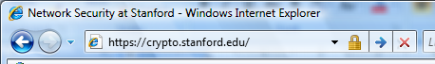
The lock icon: SSL indicator
Intended goal:
Provide user with identity of page origin
Indicate to user that page contents were not viewed or modified by a network attacker
In reality:
Origin ID is not always helpful
Company’s page can be hosted some where else
Many other problems (next few slides)
Notes:
Network attacker: controls routers, DNS; can inject, delete, and modify packets

Slide 94
When is the (basic) lock icon displayed
All elements on the page fetched using HTTPS
(with some exceptions)
For all elements:
HTTPS cert issued by a CA trusted by browser
HTTPS cert is valid (e.g. not expired)
CommonName in cert matches domain in URL

Slide 95

The lock UI: helps users authenticate site
uninformative

Slide 96

The lock UI: Extended Validation (EV) Certs
Harder to obtain than regular certs
requires human lawyer at CA to approve cert request
Designed for banks and large e-commerce sites
Helps block “semantic attacks”: www.bankofthevvest.com

Slide 97

A general UI attack: picture-in-picture
Trained users are more likely to fall victim to this [JSTB’07]
Notes:
Both inner and outer windows are focused

Slide 98

HTTPS and login pages: incorrect version
Users often land on login page over HTTP:
Type site’s HTTP URL into address bar, or
Google links to the HTTP page
View source:
<form method="post"
action="https://onlineservices.wachovia.com/..."
Notes:
User has no way to tell that his password is sent over HTTPS to site. Also has no way to tell that page wasn’t modified enroute (e.g. change form action).
Note the confusing lock next to “LOGIN” that suggests this is HTTPS.

Slide 99

HTTPS and login pages: guidelines
General guideline:
Response to http://login.site.com should be Redirect: https://login.site.com

Slide 100
Problems with HTTPS and the Lock Icon

Slide 101
Problems with HTTPS and the Lock Icon
Upgrade from HTTP to HTTPS
Semantic attacks on certs:
Invalid certs and forged certs
Certificate Issuance Woes
Mixed content
HTTP and HTTPS on the same page
Does HTTPS hide web traffic?

Slide 102
1. HTTP → HTTPS upgrade
Common use pattern:
browse site over HTTP; move to HTTPS for checkout
connect to bank over HTTP; move to HTTPS for login
Easy attack: prevent the upgrade (ssl_strip) [Moxie’08]
<a href=https://…> ⇒ <a href=http://…>
Location: https://... ⇒ Location: http://... (redirect)
<form action=https://… > ⇒ <form action=http://…>
HTTP
SSL
attacker
web server
Notes:
ssl_strip: prevents browser from upgrading, but does the SSL upgrade when communicating with the server. Server has no idea this is taking place.

Slide 103
WHAT IS SSL STRIPPING?
SSL stripping is a technique by which a website is downgraded from https to http.
In other words, the attack is used to circumvent the security which is enforced by SSL certificates on https sites. This is also known as SSL downgrading.
The attacks expose the website to eavesdropping and data manipulation by forcing it to use insecure HTTP rather than secured https.
When you enter the URL on the browser, the first connection will be a plain http before it gets redirected to secure https. The attacker takes advantage of this small window by using the SSL strip attack.
Http and Https are application protocols. Http transmits the data in plaintext whereas https sends data using a secure tunnel.

Slide 104
How to protect my website against SSL Strip attacks?
SSL or HTTPS is an idea, a wonderful idea indeed. Just like any other idea out there, there are loopholes in it. And such loopholes must be addressed. Here are the three things you can do to make your HTTPS website even more secure:
1) Enable HTTPS on pages of your website
2) Implement HSTS policy – A Strict policy under which browser won’t open a page unless the site has HTTPS.

Slide 105


Tricks and Details
Tricks: drop-in a clever fav icon (older browsers)
Details:
Erase existing session and force user to login:
ssl_strip injects “Set-cookie” headers to delete existing session cookies in browser.
⇒

Slide 106
HTTP Strict Transport Security (HSTS) is a web security policy mechanism that helps to protect websites against man-in-the-middle attacks such as protocol downgrade attacks[1] and cookie hijacking.
It allows web servers to declare that web browsers (or other complying user agents) should automatically interact with it using only HTTPS connections, which provide Transport Layer Security (TLS/SSL), unlike the insecure HTTP used alone.
HSTS is an IETF standards track protocol and is specified in RFC 6797.
The HSTS Policy is communicated by the server to the user agent via an HTTPS response header field named "Strict-Transport-Security".[1] HSTS Policy specifies a period of time during which the user agent should only access the server in a secure fashion.[2]
Websites using HSTS often do not accept clear text HTTP, either by rejecting connections over HTTP or systematically redirecting users to HTTPS (though this is not required by the specification). The consequence of this is that a user-agent not capable of doing TLS will not be able to connect to the site.
The protection only applies after a user has visited the site at least once, and the way this protection works is that a user entering or selecting a URL to the site that specifies HTTP, will automatically upgrade to HTTPS, without making an HTTP request, which prevents the HTTP man-in-the-middle attack from occurring.
https://en.wikipedia.org/wiki/HTTP_Strict_Transport_Security

Slide 107
Defense: Strict Transport Security (HSTS)
web server
Strict-Transport-Security max-age=31⋅10⁶;
Header tells browser to always connect over HTTPS
After first visit, subsequent visits are over HTTPS
self signed cert results in an error
STS flag deleted when user “clears private data” (chrome)
Compromise: security vs. privacy
Notes:
max-age is given in seconds (31.10^6) is one year.

Slide 108
Semantic Attacks:
Attacks that target the way we assign meaning to content
These are arguably the most vicious attacks,
Attackers deceive users into giving up information
Attacks exploit our mental model of content: we see a URL that looks like any other URL, along w

Slide 109
2. Semantic attacks on certs
International domains: xyz.cn
Rendered using international character set
Observation: Chinese character set contains chars that look like “/” and “?” and “.” and “=”
Attack: buy domain cert for *.badguy.cn
setup domain called:
www.bank.com/accounts/login.php?q=me.badguy.cn
note: single cert *.badguy.cn works for all sites
Extended validation (EV) certs may help defeat this

Slide 110


Slide 111
3. Invalid certs
Examples of invalid certificates:
expired: current-date > date-in-cert
CommonName in cert does not match domain in URL
unknown CA (e.g. self signed certs)
Small sites may not want to pay for cert
Users often ignore warning:
Is it a mis-configuration or an attack? User can’t tell.
Accepting invalid cert enables man-in-middle attacks (see http://crypto.stanford.edu/ssl-mitm )

Slide 112
Man in the middle attack using invalid certs
GET https://bank.com
BadguyCert
BankCert
attacker
ClientHello
ClientHello
bank
ServerCert (Badguy)
ServerCert (Bank)
bad cert
warning!
SSL key exchange
SSL key exchange
k₁
k₁
k₂
k₂
HTTP data enc with k₁
HTTP data enc with k₂
Attacker proxies data between user and bank. Sees all traffic and can modify data at will.

Slide 113
Statistics
25% of active web sites support HTTPS (port 443)
Only 3% of HTTPS sites have proper cert:
For 97% of sites domain name does not match Common Name in cert
Source: Qualys, June 2010

Slide 114

Invalid cert dialog
A difficult security prompt: user wants to proceed and doesn’t understand warning

Slide 115
4. Certificate Issuance Woes
Wrong issuance:
2011: Comodo and DigiNotar RAs hacked, issue certs for Gmail, Yahoo! Mail, …
Rogue CA:
2009: Etisalat CA in UAE
Signs software patch on behalf of RIM
PacketForensics: HTTPS MiTM for law enforcement
(see also crypto.stanford.edu/ssl-mitm )
⇒ enables eavesdropping w/o a warning in user’s browser
Notes:
Etisalat: cert. issued by Cybertrust

Slide 116
5. Mixed Content: HTTP and HTTPS
Page loads over HTTPS, but contains content over HTTP
(e.g. <script src=“http://.../script.js> )
Active network attacker can hijack session
Modifies script en-route to browser

Slide 117


Mixed Content: HTTP and HTTPS
IE7:
Chrome:
No SSL lock in address bar:

Slide 118
7. Peeking through SSL
Network traffic reveals length of HTTPS packets TLS supports up to 256 bytes of padding
AJAX-rich pages have lots and lots of interactions with the server
These interactions expose specific internal state of the page
BAM!
Side-Channel Leaks in Web Applications Chen, Wang, Wang, Zhang, 2010

Slide 119
Acknowledgements
Material in this lecture are taken from the slides prepared by:
Prof. Dan Boneh (Stanford)

